Slide 1
ASP.net and c#
Lecure2(11-08-2023)
Topic:
Getting started with visual studio
Differnce website v/s web application

Slide 2
Getting Started with Visual Studio 2017
First, you have to download and install the Visual Studio. For that, you can refer to Downloading and Installing Visual Studio 2017. Don’t forget to select the .NET core workload during the installation of VS 2017. If you forget then you have to modify the installation.
You can see a number of tool windows when you will open the Visual Studio and start writing your first program as

Slide 3
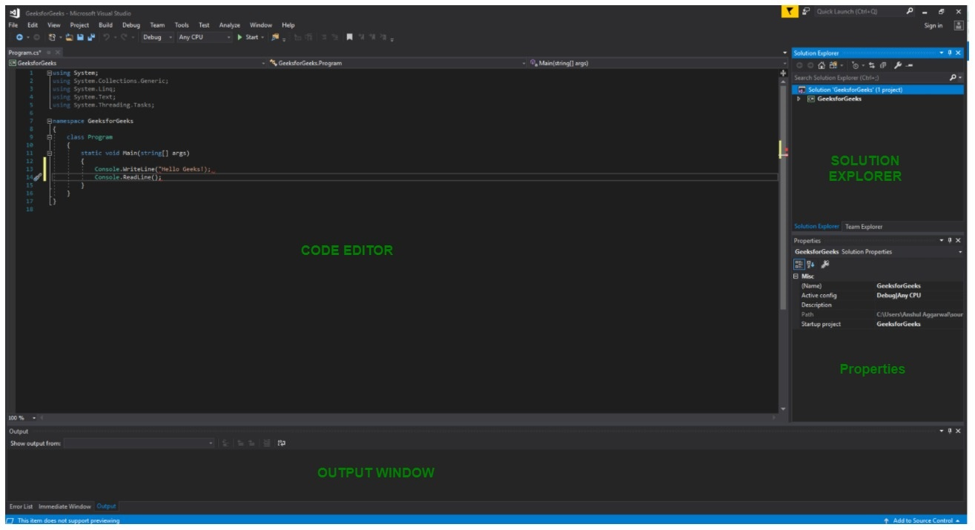

Slide 4

Code Editor: Where the user will write code.
Output Window: Here the Visual Studio shows the outputs, compiler warnings, error messages and debugging information.
Solution Explorer: It shows the files on which the user is currently working.
Properties: It will give additional information and context about the selected parts of the current project.
A user can also add windows as per requirement by choosing them from View menu. In Visual Studio the tool windows are customizable as a user can add more windows, remove the existing open one or can move windows around to best suit.
Various Menus in Visual Studio: A user can find a lot of menus on the top screen of Visual Studio as shown below

Slide 5
Create, Open and save projects commands are contained by File menu.
Searching, Modifying, Refactoring code commands are contained by the Edit menu.
View Menu is used to open the additional tool windows in Visual Studio.
Project menu is used to add some files and dependencies in the project.
To change the settings, add functionality to Visual Studio via extensions, and access various Visual Studio tools can be used by using Tools menu.
The below menu is known as the toolbar which provide the quick access to the most frequently used commands. You can add and remove the commands by going to View → Customize

Slide 6
Advantages of using Visual Studio IDE :
A full-featured programming platform for several operating systems, the web, and the cloud, Visual Studio IDE is available. Users can easily browse the UI so they can write their code quickly and precisely.
To help developers quickly identify potential errors in the code, Visual Studio offers a robust debugging tool.
Developers can host their application on the server with confidence because they have eliminated anything that could lead to performance issues.
No matter what programming language developers are using, users of Visual Studio can get live coding support. For faster development, the Platform offers an autocomplete option. The built-in intelligent system offers descriptions and tips for APIs.
Through Visual Studio IDE you can easily collab with your teammates in a same project. This IDE helps the developers to share, push and pull their code with their teammates.
Every user of Visual Studio has the ability to customise it. They have the option to add features based on their needs. For example, they can download add-ons and install extensions in their IDE. Even programmers can submit their own extensions.

Slide 7
Note:
Support for different programming languages in Visual Studio is added by using a special VSPackage which is known as Language Service.
When you will install the Visual Studio then the functionality which is coded as VSPackage will be available as Service.
Visual Studio IDE provides the three different types of services known as SVsSolution, SVsUIShell, and SVsShell.
SVsSolution service is used to provide the functionality to enumerate solutions and projects in Visual Studio.
SVsUIShell service is used to provide User Interface functionality like toolbars, tabs etc.
SvsShell service is used to deal with the registration of VSPackages.

Slide 8
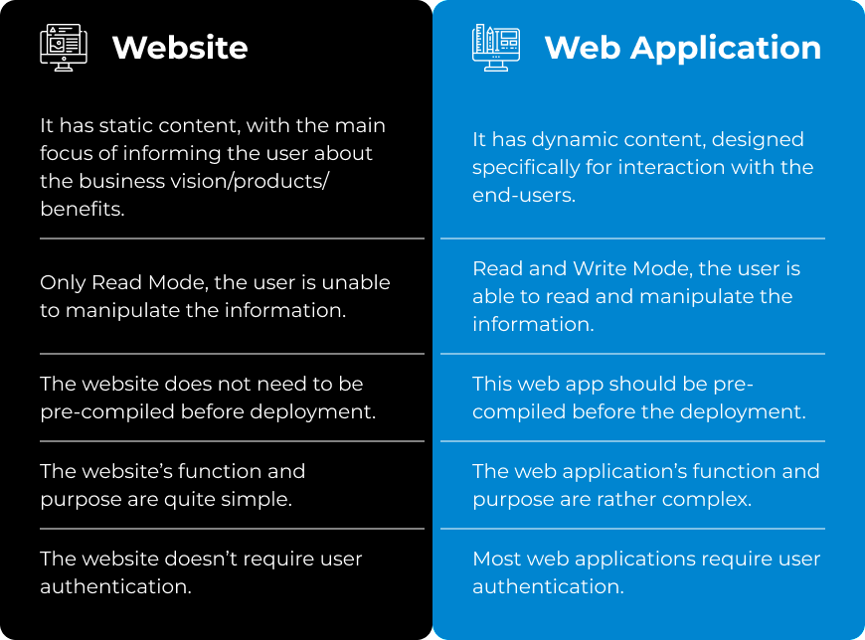
Website v/s web application

Slide 9
When you’re planning to build something on the web, one of the first decisions you’ll make is choosing between a website vs web app.
This can be a tough decision because there is sometimes confusion between these terms. A website is a collection of digital pages that are accessed through a web browser. A web app is an application that performs specific tasks and is accessed through a web browser.
So, why is there sometimes confusion between these terms? It’s probably because the line between websites and web apps has become blurred in recent years. In the early days of the web, most sites were simply collections of text and images. But as the web has evolved, more and more sites have begun to offer interactive features and functionality that were once only found in traditional desktop applications.
To make matters even more confusing, some companies use the term “website” to refer to their entire online presence, including both their website and their web app. So when you’re trying to decide if you need a website vs web app, it’s important to take into account the specific goals and features you want your site or app to have. Wesrom is highly experienced with creating both websites and web applications and can help you with custom web solutions, guide you through the process with all the information you need, help you save time and achieve a remarkable online presence.

Slide 10
WHAT IS A WEBSITE?
A website is a group of webpages that are all related to each other and are usually connected in some way. They’re typically accessed by a URL, or Uniform Resource Locator. Technically, a website can be just a single page, but most websites are much larger than that. A website is usually made up of many individual files that all work together to display the content on the screen.
A website is typically divided into several sections or pages. The main page of a website is called the home page, and it’s what most people think of when they think of a website. The home page is typically where you’ll find an overview of the entire website and links to all of the other pages on the site.
Many websites also have a section called an About page, which tells you more about the organization or person who created the site. Other common sections on websites include Contact pages, FAQs (frequently asked questions), and Blog pages.

Slide 11
The most common situations when you need to build a website:
When you want to offer clear and attractive information about your products, services and business vision.
When you want to create social proof and showcase testimonials and case studies
When you want to communicate your brand vision and create brand awareness
When you want to increase the number of leads
When you want to offer automated and fast customer support

Slide 12
WHAT IS A WEB APP?
A web app is a software application that is hosted on a web server and accessed via a web browser. Web apps are usually written in a scripting language such as PHP, Perl or Java and use a database such as MySQL or PostgreSQL to store data.
Web apps are becoming increasingly popular due to the fact that they can be accessed from anywhere in the world with an Internet connection. They also allow users to access their data from any device with a web browser, including smartphones and tablets.
Additionally, web apps can be updated and changed without having to redeploy the entire application. This makes them much more agile than traditional desktop applications.
The most common situations when you need to build a web app are:
When you want your brand to stand out of the box in the market
When you want to connect with your consumers personally, making engagement easy and smooth.
When you want to generate leads and attract prospects, but also trim down the efforts of data organization.
When you want a cost-effective option to interact with your customers: SaaS have “pay as you go” memberships.

Slide 13
WHAT IS THE DIFFERENCE BETWEEN A WEBSITE AND A WEB APPLICATION?
A website is a series of webpages that are typically accessed through a web browser and are hosted on a web server. A web application is a software program that is accessed through a web browser and runs on a web server. The main difference is that a website is static and a web application is dynamic.
A website usually consists of information about a company or individual, such as contact information, products or services offered, and general information. A web application, on the other hand, is interactive and allows users to perform tasks such as making purchases, viewing account balances, or playing games. Web applications are also often more complex than websites and require more server resources.

Slide 14
WHAT SHOULD I CHOOSE FOR MY BUSINESS?
There are a few key differences between websites and web applications that can help you make a decision about which is right for your needs.
Here are five reasons to choose a website:
Cost-Effective: Websites are typically less expensive to develop and maintain than web applications. This is because they don’t require as much complex functionality or back-end infrastructure.
Easy to Use: Websites are easy for users to navigate and use. This is because they follow familiar patterns that users are accustomed to, such as menus and links.
Accessible: Websites can be accessed by anyone with an Internet connection. This makes them a good choice for businesses that want to reach a wide audience.
Fast to Develop: Websites can be developed quickly, often in just a few weeks. This is due to their simpler design and functionality.
Flexible: Websites can be easily updated and changed without having to redeploy the entire application. This makes them more adaptable to changing needs and requirements.
There are a few key reasons to choose a web application over a website.

Slide 15
User control and ownership: With a web application, users have more control over their data and how it is used. They can also easily access their data from any device or location.
Scalability: Web applications can be scaled more easily than websites. This is due to the fact that they are designed to be maintained by a team of developers and can be updated with new features and functionality as needed.
Security: Web applications tend to be more secure than websites since they are built with security in mind from the start. In addition, web applications usually have better access controls, which can help prevent unauthorized access to sensitive data.
Performance: Web applications are designed to be fast and efficient, which can save time and resources for both users and businesses.
Functionality: Web applications often offer more functionality than websites, such as the ability to create, edit, and store data. This can make them more useful for businesses and organizations that need to track and manage large amounts of data.

Slide 16
As consumers become more tech-savvy, digital businesses are taking the place of traditional bricks and mortar. E-commerce has allowed the internet to penetrate almost every industry vertical. To compete in this difficult environment, you need a strong online presence. Depending on your business model and budget, you can choose between a website vs a web app, but no matter what you choose, we highly recommend making it custom, in accordance with your brand. Custom website and web application development are one of the best ways for your business to achieve an outstanding online presence and come out on top.

